Slide 1

SOLEY FOR THE PURPOSES OF FORAGE WORK EXPERIENCE
Utilizing web scraping techniques to gather and analyze key company data for strategic business insights

Slide 2
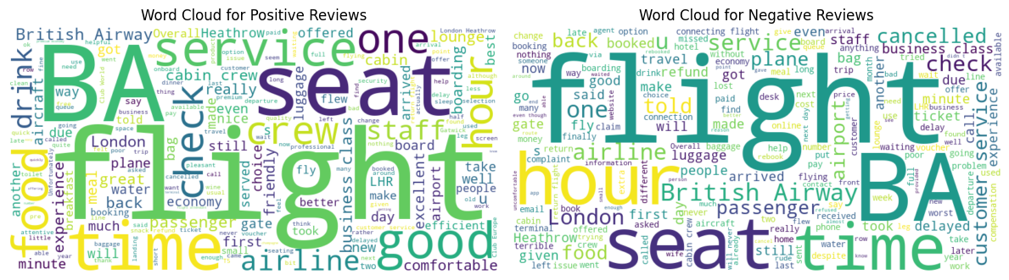
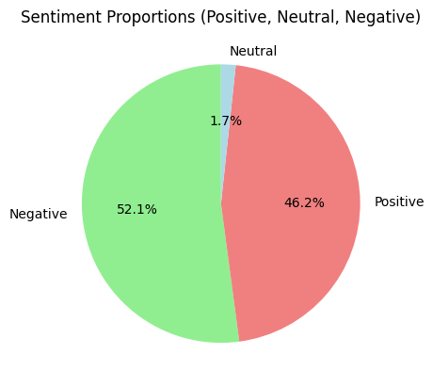
Customer Review Insight Summary
Negative feedback primarily focuses on delays, cancellations, and poor service.
Positive feedback highlights comfort, good service, and pleasant flight experience.
The sentiment proportions indicates that there is significant proportion of customers with positive sentiment , although larger shares expresses concern . Addressing the key areas of discontent will enhance the overall customer satisfaction score.

